Slide 1
TILL NOW…
Datatypes
Lists
Dictionaries
Functions
Recursion
Classes
File handling

Slide 2
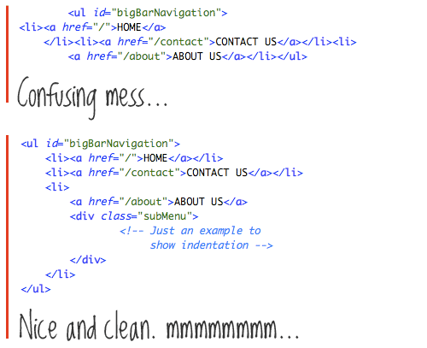
How do we program efficiently?

Slide 3
Good Programs
Correct and Efficient
Easy to read and write
Easy to debug
Easy to modify

Slide 4
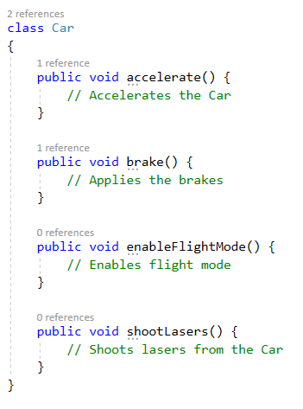
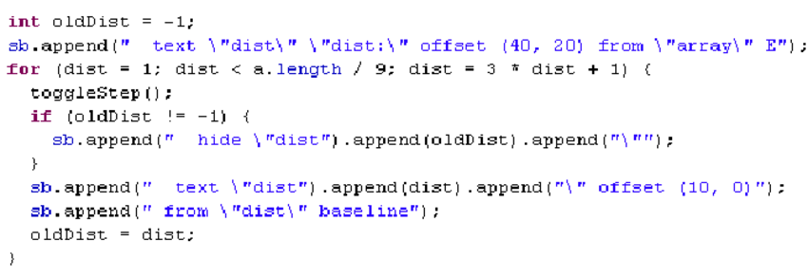
Good Programs
Easy to read and write
Commenting the code
…..

Slide 5
Good Programs
Easy to debug
Divided into short functions
…..

Slide 6
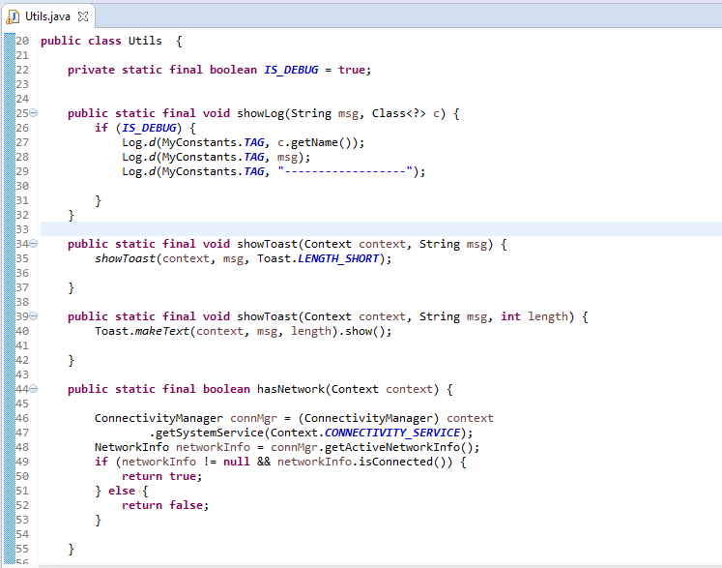
Good Programs
Easy to modify
Generalized functions, classes
…..

Slide 7
Good Programs
Correct and Efficient
Correct: “Run in accordance with specifications”
Efficient: usually Minimum Time, but other constraints such as memory use are also paramount.

Slide 8
Good Programs
Better running times
Generally most appropriate Data Structures and Algorithms
‘hacking’ doesn’t help much
Data is important

Slide 9
Let’s evaluate running times-Compound Interest Program
def raiseToPower(n,k):
if (k == 1):
return n
else:
return n * raiseToPower(n,k-1)
def compountInterest(p, r, t):
return p * raiseToPower((1 + (r/100)), t)
print(compountInterest(10000, 8, 5))

Slide 10
Let’s evaluate running times-Compound Interest Program(math ops)
def compountInterest(p, r, t):
return p * raiseToPower((1 + (r/100)), t)
Time = T_mul

Slide 11
Let’s evaluate running times-Compound Interest Program(math ops)
def raiseToPower(n,k):
if (k == 1):
return n
else:
return n * raiseToPower(n,k-1)
Time = T_mul + T_comp + T_mul (How many times??)

Slide 12
Let’s evaluate running times-Compound Interest Program(math ops)
def raiseToPower(n,k):
if (k == 1):
return n
else:
return n * raiseToPower(n,k-1)
Time = T_mul + (t)T_comp + (t-1)T_mul

Slide 13
Let’s evaluate running times-Compound Interest Program(math ops)
Do we really want to do all of this?
Time = (t) (T_mul + T_comp)

Slide 14
Let’s evaluate running times- We want to study order of growth
T(t) ~ c (Constant time)
T(t) ~ log(t) (Logarithmic time)
T(t) ~ t (Linear time)
T(t) ~ power(t,k) (Polynomial time)
T(t) ~ power(k,t) (Exponential time)

Slide 15

Let’s evaluate running times- BIG OH NOTATION

Slide 16
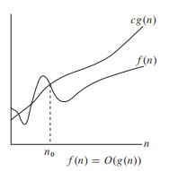
Let’s evaluate running times- BIG OH NOTATION

Slide 17
Let’s evaluate running times- BIG OH NOTATION - exercises

Slide 18

Let’s evaluate running times- BIG OH NOTATION - exercises

Slide 19

Let’s evaluate running times- BIG OH NOTATION - exercises
What is the O(f(n))?

Slide 20
Let’s evaluate running times- BIG OH NOTATION - exercises
Linear Search
Binary Search
What are the worst case and best case timings?

Slide 21
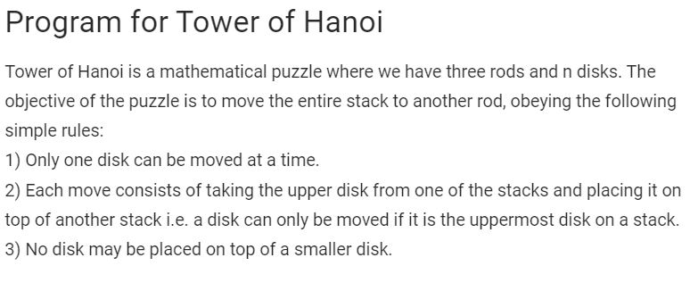
Let’s evaluate running times- BIG OH NOTATION - exercises
TOWER OF HANOI

Slide 22
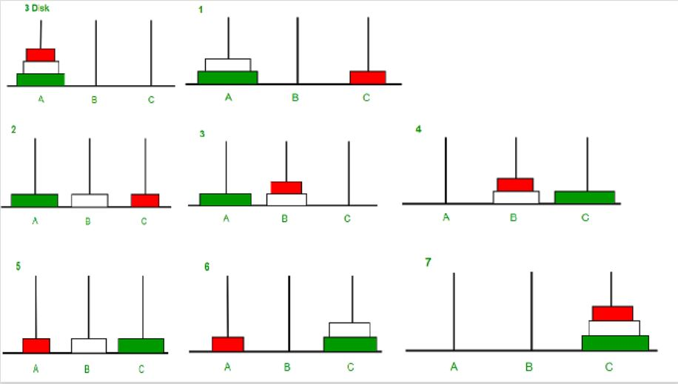
Let’s evaluate running times- BIG OH NOTATION - exercises
TOWER OF HANOI

Slide 23
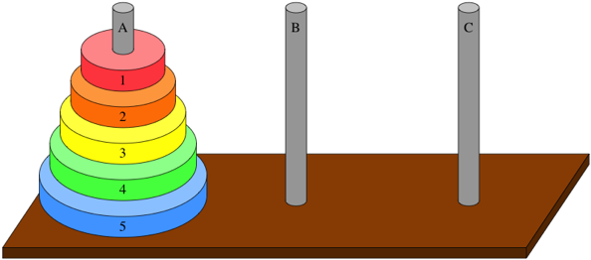
Let’s evaluate running times- BIG OH NOTATION - exercises
TOWER OF HANOI-Hint

